Slide 1



Work IN A SOCIALLY DIVERSE ENVIRONMENT
D1.HRS.CL1.19 D1.HOT.CL1.02 D2.TCC.CL1.02
Notes:
Trainer welcomes trainees to class.

Slide 2

Subject Elements
This unit comprises two Elements:
Communicate with customers and colleagues from diverse backgrounds
Deal with cross cultural misunderstandings.
Notes:
Trainer advises this Unit comprises two Elements, as listed on the slide explaining:
• Each Element comprises a number of Performance Criteria which will be identified throughout the class and explained in detail
• Trainees can obtain more detail from their Trainee Manual
• At times the course presents advice and information about various protocols but where their workplace requirements differ to what is presented, the workplace practices and standards, as well as policies and procedures must be observed.

Slide 3
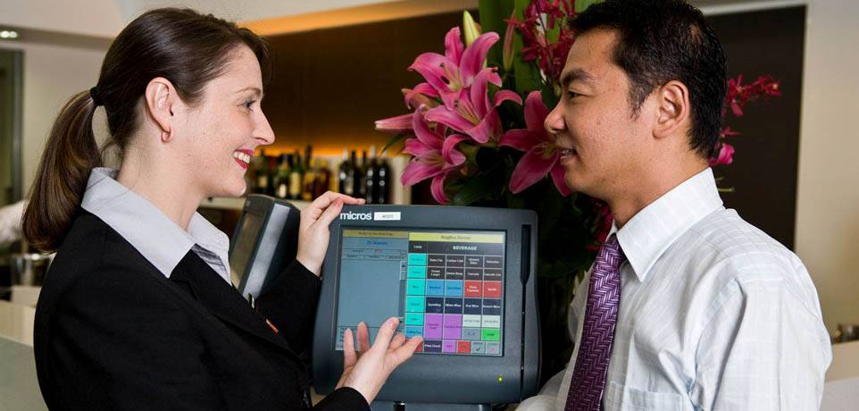
Assessment
Assessment for this unit may include:
Oral questions
Written questions
Work projects
Workplace observation of practical skills
Practical exercises
Formal report from supervisor.
Notes:
Trainer advises that assessment for this Unit may take several forms all of which are aimed at verifying they have achieved competency for the Unit as required.
Trainer indicates the methods of assessment that will be applied to them for this Unit.

Slide 4
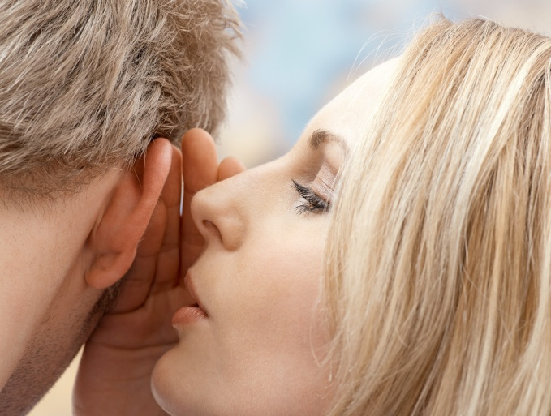
Element 1:
Communicate with customers and colleagues from diverse backgrounds
Notes:
Introduce topic.
Class Activity – General Discussion
Ask general questions:
What is communication?
Why is communication important?
What information do you communicate with customers – both internal and external?
What challenges exist when communicating with people from diverse backgrounds?

Slide 5
Communicate effectively
Performance Criteria for this Element are:
Value customers and colleagues from different cultural groups and treat them with respect and sensitivity
Take into consideration cultural differences in all verbal and non-verbal communication
Attempt to overcome language barriers
Obtain assistance from colleagues, reference books or outside organisations when required.
Notes:
Trainer identifies the Performance Criteria for this Element, as listed on the slide.

Slide 6
Valuing customers and colleagues
The hospitality and tourism industries are leading examples of multicultural industries
Many workplaces are staffed with people from various cultures
Staff interact with and serve people from different nations and cultural backgrounds.
Notes:
Class Activity – General Discussion
Trainer leads a general class discussion how diverse a hospitality environment is
Staff - What diversity exists in your business in regards to staff? What countries do they come from? What different cultures exist?
Customers - What diversity exists in your business in regards to customers? What countries do they come from? What different cultures exist? What languages do they speak?

Slide 7
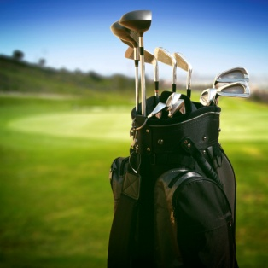
Diversity of customers and colleagues
There are a number of things that make us all different including:
The way they live
Values and principles
Educational background
Sporting interests
(Continued)
Notes:
The way they live – including where and how they live
Values and principles – the importance placed on people, actions and things, and personal guidelines for living life
Educational background – how far they got through schooling, and whether or not they did any further education
Sporting interests – whether they play sport, or whether they are even interested in sport: and which sport
Class Activity – General Discussion & Exercise (incorporates this and next slide)
Discuss the diversity of the audience in relation to these points. Write the answers down on the board.
You will find a great amount of diversity just amongst this group. Imagine the expanse of diversity given all the staff and customers in a typical hospitality business.
Given the list you have developed, what can a hospitality business do to help cater to these cultural differences?

Slide 8
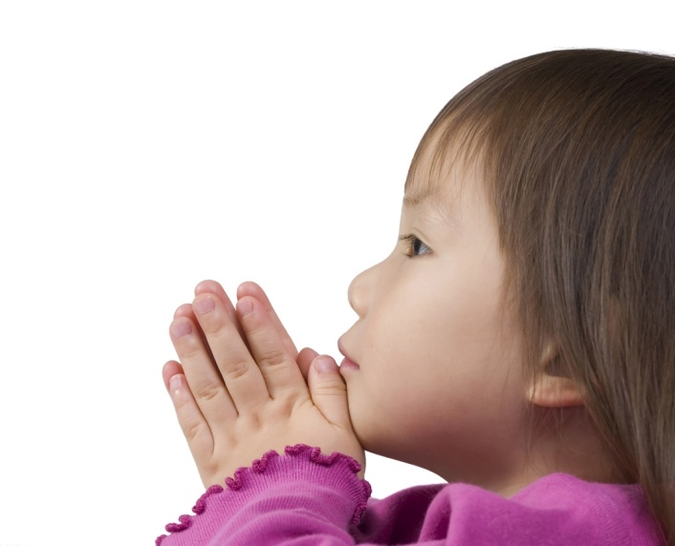
Diversity of customers and colleagues
Food and beverage tastes
Lifestyle background
Place of birth
Styles of communication
Religious beliefs
Preferred language.
Notes:
Food and beverage tastes – do they drink alcohol or prefer juice, do they eat red meat or are they vegetarian?
Lifestyle background – what car do they drive, where have they worked?
Place of birth – which country where they born in?
Styles of communication – what is their preferred communication medium and method?
Religious beliefs – who or what do they believe in?
What is their preferred language?
Class Activity – General Discussion & Exercise (incorporates this and past slide)
Discuss the diversity of the audience in relation to these points. Write the answers down on the board.
You will find a great amount of diversity just amongst this group. Imagine the expanse of diversity given all the staff and customers in a typical hospitality business.
Given the list you have developed, what can a hospitality business do to help cater to these cultural differences?

Slide 9

Valuing customers and colleagues
An essential element of working in a socially diverse environment is to make sure that customers and colleagues feel valued:
How can you make customers and colleagues feel valued?
Notes:
Class Activity – General Discussion
Answer question in slide
Is there a different approach you need to take when dealing with customers as opposed to colleagues?

Slide 10
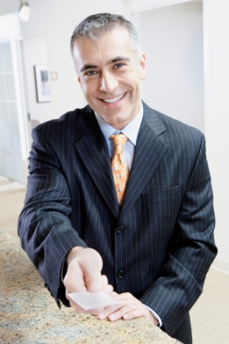
Valuing colleagues
You must therefore make sure other staff understand that you place worth on their:
Working abilities and skills
Workplace and product knowledge
Experience
Their contribution to discussions
Achievement of team and workplace goals.
Notes:
Class Activity – General Discussion
How do you show you value colleagues?

Slide 11

Valuing customers
Make sure all customers understand you place worth on their:
Presence on the premises
The money they spend with us
The other customers they bring to the business.
Notes:
Class Activity – General Discussion
How do you show you value customers?

Slide 12
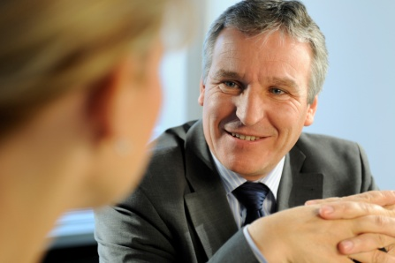
Respect
Respect means:
Holding that person in high regard for who they are, not what they are
Being deferential in the way the person is treated’
Showing courtesy to the person.
Notes:
Class Activity – General Discussion
What is respect?
How can you get the respect of others?
How do you show respect to someone else?

Slide 13

Sensitivity
Being sensitive to the cultural needs of others involves:
Identifying what their cultural or social background is
Determining what special considerations should be given to that person
Taking action to ensure that their specific cultural needs are met to the best of your ability, in-line with your other work-related obligations.
Notes:
Class Activity – General Discussion
What is sensitivity?
How do you show sensitivity to someone else?
What is harder to do – show respect or sensitivity?

Slide 14

Sensitivity
In essence, being sensitive means knowing that another person merits consideration based on their cultural or social background, and accommodating that need.
Notes:
Class Activity – General Discussion
Provide examples of where you have considered someone else and accommodated there need.

Slide 15
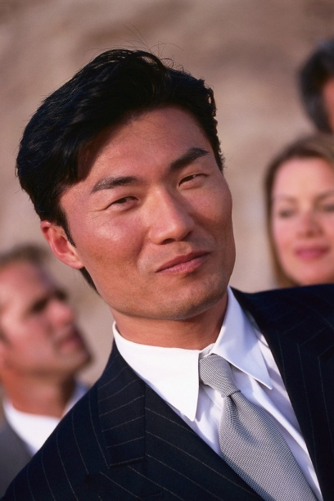
Different cultural groups
Colleagues and customers come from all corners of the globe including:
ASEAN countries
Other Asian countries
European Community countries
Middle Eastern countries
Subcontinent Countries
North & South American countries
African Countries
Oceania Countries.
Notes:
Class Activity – List and discuss
Identify different countries located within the geographical areas listed in this slide
For each country identify some cultural characteristics and needs.
Identify how a hospitality business can cater to these needs.

Slide 16

Different cultural groups
Diversity of colleagues
Our industry traditionally employs people from many countries either as full-time staff who have:
Residency in the country
Work visas.
Some of these will be first generation and many will be second or third generation.
Notes:
Class Activity – Discussion
What different countries are staff in your organisation from?
Class Activity – General Discussion & Exercise (incorporates this and past slide)
Discuss the diversity of the audience in relation to these points. Write the answers down on the board.
You will find a great amount of diversity just amongst this group. Imagine the expanse of diversity given all the staff and customers in a typical hospitality business.
Given the list you have developed, what can a hospitality business do to help cater to these cultural differences?

Slide 17

Different cultural groups
Diversity of customers
Every hospitality and tourism business will have specific countries from which their customers come from
It is important that the organisation and their staff understand the profile of their customers
This enables them to tailor their products and services.
Notes:
Class Activity – Discussion
What different countries are customers coming to an organisation in your region from?
Why do they come to your region?
How can you tailor products and services to meet their needs?

Slide 18
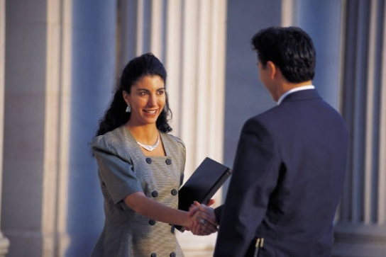
Understanding cultural differences
Knowing about the various cultural differences that exist does not come naturally.
The first requirement in understanding these differences is a desire to find out about:
How these cultures vary
How you can accommodate those needs.
Which businesses are successful in catering to different cultural customers?
Notes:
Class Activity – Discussion
This slide contains the same topic as the previous slide.
You may wish to discuss businesses who have successfully catered to the needs of different cultural markets.

Slide 19
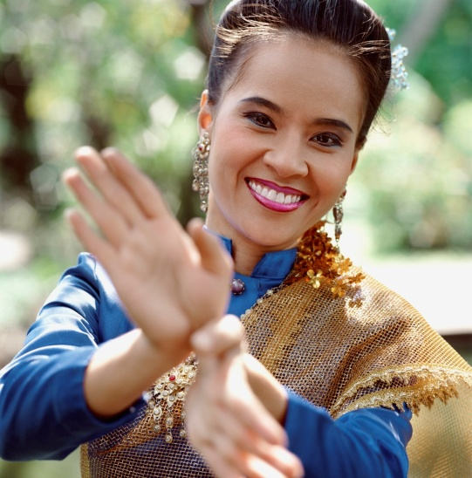
Learning about cultural differences
Cultural awareness programs
Basic greetings and phrases
Body language of that country
General expectations of people from that country
History of their country
Basic geographical awareness.
Notes:
Class Activity – Discussion
What are some examples of each point identified in this slide?

Slide 20
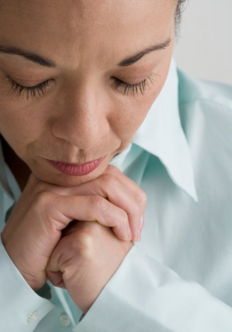
Learning about cultural differences
Cultural awareness programs
Contributions made by that country to the world
Religious issues and observations
Values and value systems
Customs and taboos
Beliefs
Role and importance of family.
Notes:
Class Activity – Discussion
What are some examples of each point identified in this slide?

Slide 21

Learning about cultural differences
Talk to people from different cultures and countries
Staff
Customers
Friends
Network of contacts industry
Industry stakeholders
(Continued)
Notes:
Class Activity – Discussion
What are some examples of each point identified in this slide?
What can you learn from them?

Slide 22

Learning about cultural differences
Reading books
Watching DVDs
Online research
Visit embassies and consulates of various countries.
Notes:
Class Activity – Discussion
What are good websites you would look up?
What are some examples of each point identified in this slide?
What can you learn from them?

Slide 23
Considering cultural differences
Working in a socially diverse environment necessitates communicating with people from different cultural and social backgrounds.
Ensure that the two components of communication are appropriate to the person and culture being communicated with:
Verbal language
Body language.
Notes:
Class Activity – Discussion
How do you use verbal language to communicate?
How do you use body language to communicate?

Slide 24

Types of cultural differences
The cultural differences that you must ensure you take into account may relate to:
Race
Language
Special needs
Family structure
Disabilities
Gender
Age
Sexual preference.
Notes:
Class Activity – Group Exercise
Break the audience into groups and give each group one point identified in this slide.
For each of the points identified in this slide:
Provide examples
Provide how these differences may cause problems
Identify ways a hospitality organisation can accommodate these cultural differences – considering products and services

Slide 25

Law and culture
All people should be valued and treated with respect when it comes to their individual differences
Equal Opportunity legislation was created to be enforced in society in general with specific emphasis on activities in all workplaces.
Notes:
Class Activity – Research and discuss.
The class should research specific equal opportunity legislation and/or employment law as applied to your country.
What specific laws exist to provide equality in the work place?
What areas or topics do these laws cover?

Slide 26

Law and culture
Objectives of EO legislation
To promote recognition and acceptance of everyone’s right to equality of opportunity
To eliminate discrimination against people by prohibiting discrimination on the basis of various ‘listed attributes’
To eliminate sexual harassment.
Notes:
Class Activity – Discussion
Based on your research in the past slide:
Do these generic objectives differ in your country?
What are the differences and why do they exist?

Slide 27

Law and culture
The ‘listed attributes’
Age
Breastfeeding
Carer status
Disability/impairment
Gender identity
Industrial activity
Lawful sexual activity
Marital status
Parental status.
Notes:
Class Activity – Discussion
Based on your research in the past slides:
Are there specific legal requirements for each of these points that apply in a hospitality business?

Slide 28

Law and culture
The ‘listed attributes’
Physical features
Political belief or activity
Pregnancy
Race
Religious belief or activity
Sex/gender
Sexual orientation
Personal association (assumed or actual) with anyone who has one or more of the above characteristics.
Notes:
Class Activity – Discussion
Based on your research in the past slides:
Are there specific legal requirements for each of these points that apply in a hospitality business?

Slide 29

Stereo types
When dealing with people it is important not to use stereotypes.
Never assume that someone fits into a particular category, simply based on what you think is the case based on personal observation, information given to you by other staff, your personal experience or your individual perspectives.
Notes:
Class Activity – Discussion
What are common stereo types that exist?
Identify different countries and think of generic stereotypes we may have about people from them?
How true are these stereotypes?
What stereotypes does the rest of the world have about people from your country?
How true are these stereotypes?

Slide 30

Verbal and non verbal communication
Keys in factoring in appropriate verbal and non-verbal communication when dealing with people from another culture include:
Identify the country and culture
Take time to plan what to say and how to say it
Be mindful of your body language
Avoid industry and establishment jargon
(Continued)
Notes:
Class Activity – Discussion
Provide examples for each point in this slide and how they can easily cause communication problems.
Provide examples of how these can be applied correctly for effective communication.

Slide 31
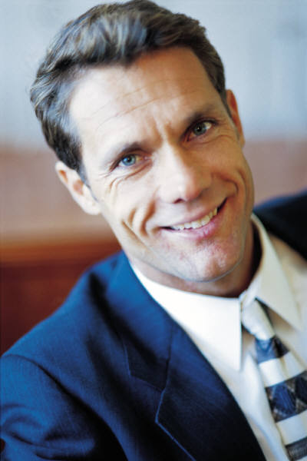
Verbal and non verbal communication
Avoid local expressions
Avoid complex statements
Give the person your full attention
Use alternative communication strategies to support the verbal communication
Be alert to feedback from the other person.
Notes:
Class Activity – Discussion
Provide examples for each point in this slide and how they can easily cause communication problems.
Provide examples of how these can be applied correctly for effective communication.

Slide 32
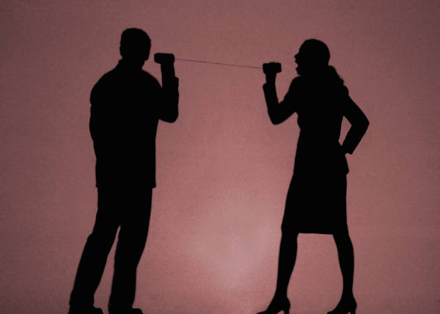
Overcoming language barriers
You should identify the languages that need to be taken into account
There are often 2-4 common foreign languages spoken by the majority of customers
Develop phrases in these languages.
Notes:
Class Activity – Discussion
What are the common foreign languages used by the majority of customers in your country? Select a maximum of 4 languages.
What are some phrases that would be useful to know?
Class Activity – Language Phrases
Research, identify and practice some of the phrases in small groups. You may want to write them on pieces of paper with the foreign phrase on one side and your language on the other. Read out the phrase and see if the audience can a) identify the language b) identify the phrase

Slide 33
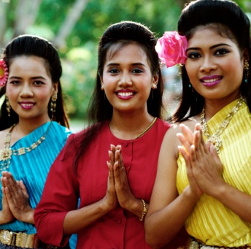
Language phrases
Meet, greet and farewell customers
Provide simple directions
Give simple instructions
Answer simple enquiries
Prepare for, serve and assist customers
Describe goods and service.
Notes:
Meet, greet and farewell customers – at different times of the day, and to different types of customers including men, women, children and business people
Provide simple directions – to the restaurant, bar, swimming pool, different floors, various rooms as well as to common landmarks and tourist attractions
Give simple instructions – on how to use telephones, how to operate in-room and venue facilities
Answer simple enquiries – such as questions relating to availability of rooms, process of goods and services and local conditions
Prepare for, serve and assist customers – in accordance with your designated work role and responsibilities. For instance, the language needs of a front office receptionist will differ to those of a room attendant which will be, in turn, different to those required by a food and beverage waiter or a bar attendant
Describe goods and service – once again this will relate to your specific workplace role. For example, a food waiter should be able to describe tastes, smells, ingredients, cooking styles, portion sizes and so on.
Class Activity – Discussion
Explain the information you would like to communicate within the points mentioned in the slide.

Slide 34
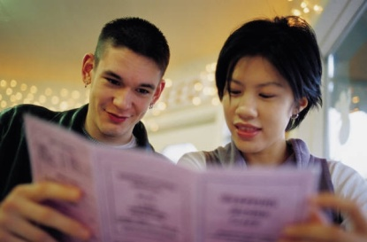
Language phrases
Simple words in foreign languages
To greet and welcome
To farewell and say goodbye
Count the numbers 1 – 10
The days of the week and months of the year
Titles used by people including Mister and Missus
Basic functions – walk, drive, sleep, eat and drink
Basic establishment facilities
Basic products and services
Methods of transportation.
Notes:
Class Activity – Discussion
Identify phrases you would like to communicate for each of the points mentioned in the slide.

Slide 35
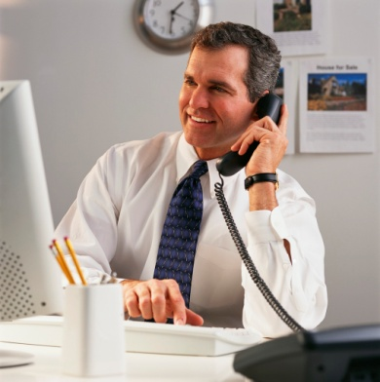
Language phrases
Where can you learn phrases from?
Customers
The internet
A foreign language dictionary
Staff
Contacting a local ethnic club/association.
Notes:
Class Activity – Discussion
What could you learn from each source?
What are good internet websites to use?

Slide 36

Verbal communication
When speaking to a person from a different culture, it is important to take into consideration their particular cultural differences:
Pitch or tone of your voice
Volume of the talking
Speed at which you talk
Pauses in the conversation.
Notes:
Class Activity – Discussion
For each of the points mentioned in the slide, what techniques could you use to make your verbal communication effective?

Slide 37

Non verbal communication
Non-verbal communication occurs in all person-to-person situations
Some people use more non-verbal communication than others, though we all use it to some degree
Non-verbal communication is traditionally more important when communicating with someone from a culturally diverse background where there is a spoken word language difficulty.
Notes:
Class Activity – Discussion
How can you use non-verbal communication to actually communicate?

Slide 38

Non verbal communication
Types of non-verbal communication
Stance and posture
Speed with which you move
Facial expression
Hold your arms
Hand and finger gestures
Personal hygiene
Eye contact.
Notes:
Class Activity – Discussion
What do each of these types of non-verbal communication communicate?
See below for examples.
Your stance and posture may be interpreted as:
Shoulders back – positive attitude
Shoulders slumped forward – negative attitude
The speed with which you move may be interpreted as:
Slow walk – don’t care
Fast walk – flat out and stressed
Your facial expression may be interpreted as:
Grumpy face – don’t want to be at work; don’t like the person they are talking to
Smiling face – happy with life; happy to work with customers
How you hold your arms may be interpreted as:
Arms crossed – defensive
Arms at your side – open to discussion
Hand and finger gestures may be interpreted as:
Waving a hand – saying goodbye
Curling a finger - beckoning
The thumbs up – all is okay or some other more abusive message!
How you attend to your personal hygiene may be interpreted as:
Bad body odour – don’t care attitude; disrespect for others
Hair tied back neatly – person with pride; respect for others
Eye contact may be interpreted as:
Direct eye contact – telling the truth, intimidating, sexual
No eye contact – not listening, disinterested or lying.

Slide 39

Non verbal communication
Language barriers - the role of gestures
When faced with a language barrier, service staff should attempt to communicate through the use of gestures or simple words:
What gestures can you use?
Notes:
Class Activity – Charades
Get the audience to play charades. Get them to communicate just using gestures.

Slide 40
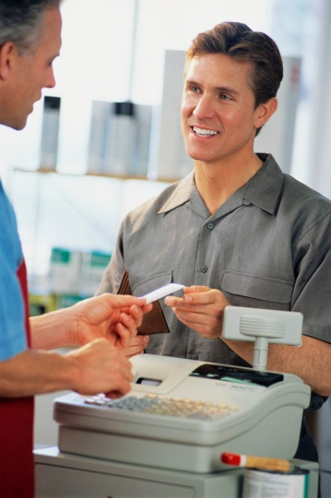
Non verbal communication
Language barriers - the role of gestures
Gestures may include:
Pointing to indicate a location, a position or a menu item
Holding fingers up to establish quantities
Rubbing your hands to indicate temperature
Nodding your head in agreement
Shaking your head in disagreement
Using facial expressions to relay your feelings.
Notes:
Class Activity – Discussion
Discuss points.

Slide 41
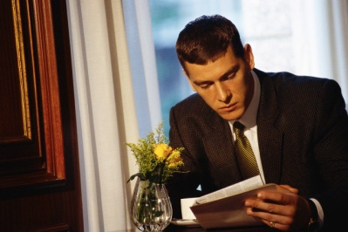
Written communication
Written communication in other languages is very effective in transferring information to customers:
What written communication would you prepare in other languages?
Who can do this for you?
Notes:
Class Activity – Discussion
Discuss questions in the slide.

Slide 42

Sign language
When communicating with deaf people, it can be extremely useful to be able to use sign language.
It may be worthwhile learning a few signs to help communicate:
What ‘signs’ do you know?
Where can you learn ‘signs’?
Notes:
Class Activity – Discussion
Discuss questions in the slide.

Slide 43

Obtaining assistance
No business will expect you to be proficiently communicate with people from all other countries
It is good to learn the basics
You will need to get help from other people, various agencies or external organisations.
Notes:
Class Activity – Discussion
Where can you get help, both inside and outside of the business?

Slide 44

Obtaining assistance
You can get assistance from:
Colleagues
Customers
Teachers – in-house and industry trainers
Family, friends and acquaintances
Service providers
Suppliers
Supervisors
Sign Language Companies
Translating and Interpreting Service.
Notes:
Class Activity – Discussion
What assistance can you get from each person identified in the slide

Slide 45

Obtaining assistance
Written information
The Internet engine
Media
Local cultural centres
Local library
Language centres
Hospitality, industry and events industry groups or organisations
Government or private training and educational providers
Purchased or borrowed books.
Notes:
Class Activity – Discussion
What assistance can you get from each person identified in the slide

Slide 46
Obtaining assistance
Outside organisations
Interpreter services
Diplomatic services
Appropriate government agencies
Individual agencies specific to unique needs
Ministry of Immigration
Educational institutions
Disability advocacy groups.
Notes:
Class Activity – Discussion
What assistance can you get from each person identified in the slide

Slide 47
Obtaining assistance
Outside organisations
Interpreter services
Diplomatic services
Appropriate government agencies
Individual agencies specific to unique needs
Department of Immigration and Citizenship
Educational institutions
Disability advocacy groups.
Notes:
Class Activity – Discussion
What assistance can you get from each person identified in the slide

Slide 48

Element 2:
Deal with cross cultural misunderstandings
Notes:
Introduce topic.
Class Activity – General Discussion
Ask general questions:
What is a misunderstanding?
What are common cross cultural misunderstandings?
What are they caused by?
How can they be avoided?

Slide 49
Communicate effectively
Performance Criteria for this Element are:
Identify issues which may cause conflict or misunderstanding in the workplace
Address difficulties with the appropriate people and seek assistance from team leaders or others where required
Consider possible cultural differences when difficulties or misunderstandings occur
Make efforts to resolve misunderstandings, taking account of cultural considerations
Refer issues and problems to the appropriate team leader/supervisor for follow up
Notes:
Trainer identifies the Performance Criteria for this Element, as listed on the slide.

Slide 50

Conflict and misunderstanding
What is conflict and misunderstanding?
Anything that upsets another person, whether a customer or colleague, can be regarded as a conflict or a misunderstanding.
Notes:
Class Activity – Discussion
What are common conflicts you have in your private life?
What causes them?
How can they be solved?

Slide 51
Addressing conflict and misunderstanding
Addressing workplace conflict and misunderstanding properly and as early as possible seeks to:
Keep all conflict and misunderstanding at the ‘mild’ end of the spectrum
Clarify any perceptions that arose due to misunderstanding
Rectify the situation to the greatest extent possible.
Notes:
Class Activity – Discussion
What are some ways to handle a conflict quickly?

Slide 52

Causes of conflict and misunderstanding
Difficulties or conflict can also arise out of misunderstandings due to:
Poor communication
Lack of communication
Intolerance
Impatience
Poor judgment
Conflicting personal values, beliefs and opinions
Personal prejudices.
Notes:
Class Activity – Discussion
Get the audience to provide examples of conflict in each identified point.

Slide 53

Causes of conflict and misunderstanding
Examples of situations that can cause conflict or misunderstanding
Welcoming guests
Giving directions or instructions
Answering questions
Serving customers
Offering an alcoholic drink to someone whose religion forbids the consumption of liquor.
Notes:
Class Activity – Discussion
Get the audience to provide examples of conflict in each identified point.

Slide 54

Causes of conflict and misunderstanding
Examples of situations that can cause conflict or misunderstanding
Recommending pork or shellfish dishes to Jewish customers
Serving meat-based dishes to people who are Hindu
Describing products, services and facilities
Working with colleagues arising
Socialising with colleagues after work.
Notes:
Class Activity – Discussion
Get the audience to provide examples of conflict in each identified point.

Slide 55

Identifying conflict and misunderstanding
Issues causing conflict or misunderstanding in the workplace are most commonly identified by:
Intuition
Personal observation
Being informed by the person themselves
Being told by another person that you have upset someone.
Notes:
Class Activity – Discussion
What is the best way to identify a conflict in your point of view?

Slide 56

Identifying conflict and misunderstanding
When conflict is identified, remember:
It isn’t always your fault
Be open-minded to their assertion that you said or did something unacceptable
Apologise where necessary
Take steps to make sure you don’t repeat any actions or statements that gave rise to the issue.
Notes:
It isn’t always your fault – the misunderstanding may be caused by their misinterpretation of facts or words
Be open-minded to their assertion that you said or did something unacceptable – don’t immediately become defensive and start trying to defend a position that is essentially wrong or indefensible
Apologise where necessary – it is truly amazing how many issues, disputes, misunderstandings and conflicts can be successfully resolved by a simple yet genuine and sincere apology
Take steps to make sure you don’t repeat any actions or statements that gave rise to the issue – this should apply even where you believe you were genuinely not ‘at fault’. The crux of the decision to change your actions or words should not be whether you are, in fact right or wrong in what you said or did, but whether or not it actually gave offence or upset someone.

Slide 57

Addressing difficulties
Where cross-cultural misunderstandings occur, efforts to resolve the situation should be made with the person concerned
But addressing difficulties and resolving them is not always a straight-forward task or one that can be readily achieved
When you can’t rectify or retrieve the situation, get help from others.
Notes:
Class Activity – Discussion
Why can’t a staff member solve all problems?
When would you get help from others?
Who would you go to for help?

Slide 58

Addressing difficulties
Scope of authority
Guidelines as to what action they can take in the workplace without having to get special permission from management:
Their ability to act on behalf of the venue
Their authority to spend money on behalf of the venue
Their authority to act in given situations.
Notes:
Class Activity – Discussion
What scope of authority do line staff normally have when handling difficulties.

Slide 59

Addressing difficulties
Scope of authority
Establishments may give staff standard scopes of authority to respond in standard ways such as:
Offering a free product – glass of drink or free dessert
Offering a service – such as dry cleaning
Offering a set percentage discount on advertised selling prices.
Notes:
Class Activity – Discussion
What are some examples in different departments?

Slide 60

Addressing difficulties
Where your scope of authority is insufficient to deal with the problem, assistance from others should sought.
Keys in involving other people are to:
Make every genuine and realistic effort to resolve the issue yourself
Act quickly once the decision to involve someone else has been taken
Make sure you give them all the
Try to stay around to listen and learn from how they handle the situation.
Notes:
Class Activity – Discussion
Discuss points

Slide 61

Addressing difficulties
Tips when addressing conflict and misunderstandings
Quick identification of a misunderstanding can prevent a conflict from occurring
All possible cultural differences should be taken into consideration
Resolve the misunderstanding as quickly as possible
Follow organisational procedures
Putting yourself in the other person’s shoes
Frustration or impatience should be avoided
Focus on respect and sensitivity.
Notes:
Class Activity – Discussion
What are other tips you may have when addressing conflicts and misunderstandings?

Slide 62
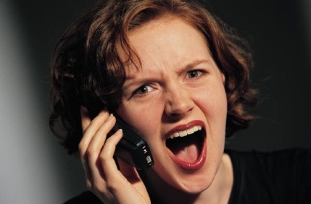
Consider cultural differences
It is possible that the cause of differences and difficulties are due to traditional service problems such as poor service, slow service, low-quality products or unclean rooms
However when dealing with people from diverse backgrounds it is also possible that cultural differences have caused the problems.
Notes:
Class Activity – Discussion
What are common cultural differences?

Slide 63

Consider cultural differences
Possible cultural differences and needs
Language spoken
Forms of address
Levels of formality/informality
Non-verbal behaviour
Work ethic.
Notes:
Class Activity – Read and Discussion
Read the notes from the Training Manual in reference to these points. The relevant pages are 34-36.
Discuss how different cultures view the points in the slide and how it can cause conflict.

Slide 64
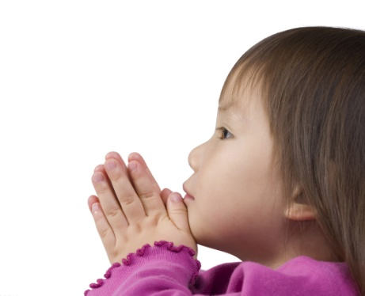
Consider cultural differences
Possible cultural differences and needs
Personal grooming and dress
Hygiene habits
Family, social obligations and status
Observance of special religious, feast or other celebratory days
Customs, beliefs and values
Product preferences.
Notes:
Class Activity – Read and Discussion
Read the notes from the Training Manual in reference to these points. The relevant pages are 37 – 39.
Discuss how different cultures view the points in the slide and how it can cause conflict.

Slide 65
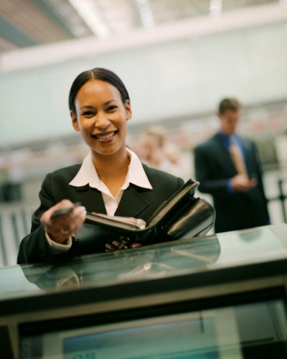
Resolving misunderstandings
When faced with a misunderstanding in the workplace, we must be prepared to think about all cross-cultural factors likely to affect the situation
When a cross-cultural misunderstanding occurs with a customer, it is necessary for service staff to take the appropriate steps to find a resolution
All talk should be honest, explained clearly, briefly and in simple unbiased terms.
Notes:
Class Activity – Discussion
Think about conflicts that have occurred in the past. How did you resolve these misunderstandings?

Slide 66

Resolving misunderstandings
Actions that can help resolve the situation
This may involve you in:
Discussing the issue in a courteous manner
Speaking directly with the person concerned in a respectful way
Apologising for offence or misunderstanding that may have been caused
Taking time to talk with the person concerned
Asking for advice from the other party.
Notes:
Class Activity – Discussion
Discuss points.

Slide 67
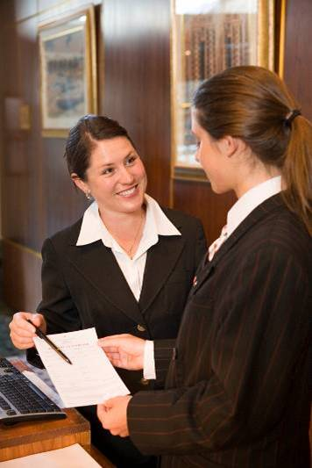
Resolving misunderstandings
Actions that can help resolve the situation
This may involve you in:
Seeking advice from a supervisor or manager about the issue
Attending mediation
Enrolling in a language class
Enrolling in cultural awareness or interpersonal skills programs.
Notes:
Class Activity – Discussion
Discuss points.

Slide 68
Refer issues and problems
There may be a need in your workplace to refer:
Any issues relating to cross-cultural issues
Unresolved issues
Who do you refer issues to?
When should they be referred?
Notes:
Class Activity – Discussion
Discuss questions in the slide.

Slide 69

Refer issues and problems
Difficulties exist by trying to:
Accommodate the needs, wants and preferences of a customer or staff member from another culture
AND
Respect the needs, wants and preferences of local employees.
Notes:
Class Activity – Discussion
Provide examples of when it is hard to meet the needs of both the customer and the organisation and their staff.

Slide 70
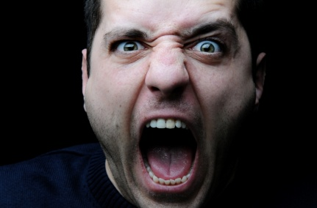
Refer issues and problems
Know when to refer issues to management
It is always important to know when and where to draw the line in relation to any cross-cultural misunderstanding:
Notify the appropriate person when you don’t seem to be making any headway in reaching a resolution
Notify the appropriate person after you believe you have come to a solution.
Notes:
Class Activity – Discussion
What is ‘your line’ when it is time to stop handling a situation and to refer it to someone else?

Slide 71
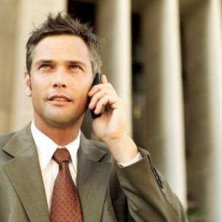
Refer issues and problems
This should be done so that any necessary follow-up and debriefing can be arranged including:
Revisions to standard operating procedure within the establishment
Inclusion of the issues at staff meetings and briefing sessions
Making contact with those involved in order to:
Demonstrate their concern in relation to the matter
Ensure that the agreed solution has genuinely resolved the situation.
Notes:
Class Activity – Discussion
Discuss point.

Slide 72
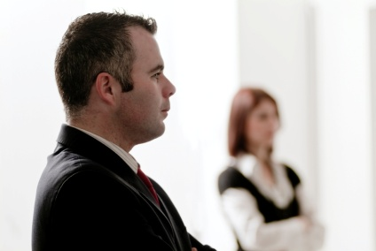
Refer issues and problems
Who should problems be referred to?
Depending on the establishment, and its organisational structure, the appropriate person could be:
Your team leader
Your supervisor
The manager
The owner.
Notes:
Class Activity – Discussion
What is the protocol of referring issues?
Is the team leader or supervisor the first contact point or can you go higher?
When do you do higher?

Slide 73
Finish: Thank you!
Notes:
This is the conclusion of the subject.
Thank the audience and deliver assessments as required.

